Slide 1

Analysis of Autism Prevalence among U.S States
By: Hannah Raquel Melio

Slide 2

Reasoning and Purpose
Analyze autism prevalence data to understand trends over time and differences across state
Real data that is meaningful to me and others
My questions:
  What is the autism prevalence rate for each year included in the dataset?
  Which years show the largest increases in autism prevalence across states?
  How does autism prevalence differ by state in the most recent year of data?
  How has the reported autism prevalence changed from the earliest year in the dataset to the most recent year?

Slide 3
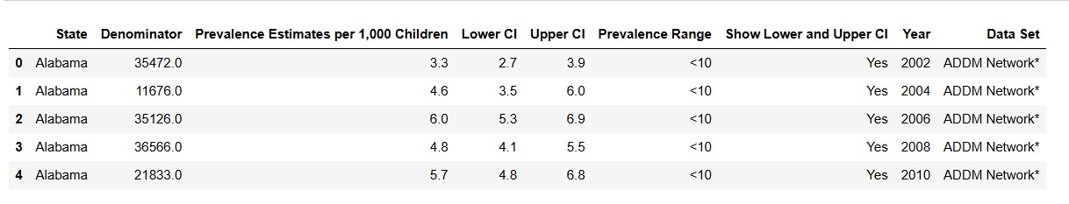
Methodology
I used a .csv file from the CDC
Python, PANDAS, Matplotlib,
Each row in the dataset represents a U.S. State
The main characteristics I worked with include:
  State
  Year
  Autism prevalence per 1,000 children
Head of Raw Data:

Slide 4
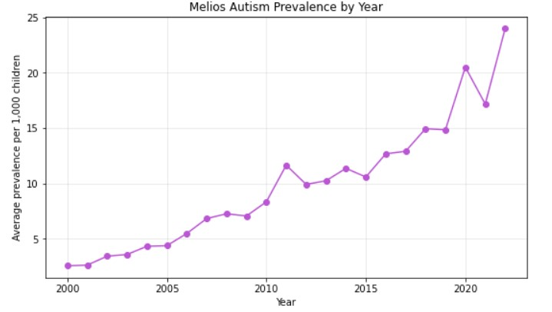
Question 1: What is the autism prevalence rate for each year included in the dataset?
I used a Line Chart to demonstrate the changes
Strong positive correlation
Possible follow up question:
  What causes the peaks seen at ~2011/2012 and ~2021
Line chart showing autism prevalences increasing over the years

Slide 5
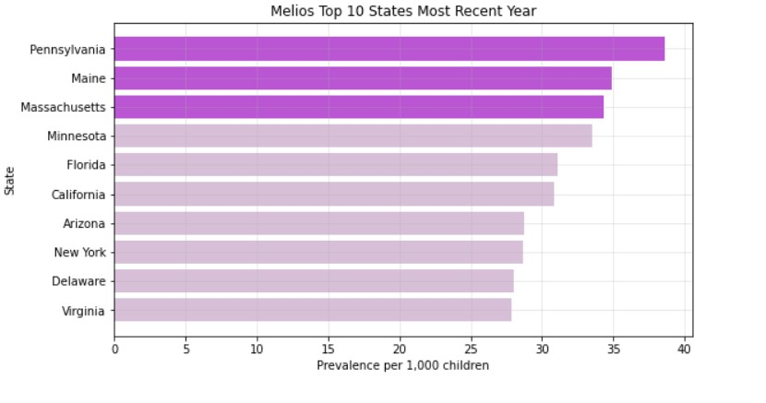
Question 3: How does autism prevalence differ by state in the most recent year of data?
Autism prevalence varies by state, highlighting differences in:
  screening
  reporting
  access to services
Top 3 :
  Pennsylvania
  Maine
  Massachusetts
Horizontal Bar Graph Showing the Prevalence per State (highlighting top three)

Slide 6

Future Work
Explore demographic factors
Compare regions
Examine access to diagnostic services
Include newer data
Include age

Slide 7

Thank You for Listening

